Slide 1
Regulation of Appetite
First presentation is on Thursday
Please read the posted news and article before class!

Slide 2
Learning Objectives
Discriminate between the different biological and psychological impulses to eat.
Explain the differences between energy intake, and energy ingestion and list some factors that may confound the relationship between intake and energy balance.
Describe the source and effects of gastrointestinal, hormonal and metabolic signals that affect appetite.
Consider how hormonal, metabolic and genetic factors may be predictive of feeding habits, and how this could inform individualized approaches.
Apply these biological mechanisms to predict how appetite suppressant drugs function.
Explain the relationships between energy expenditure and energy intake, including the timing of this relationship
Apply your knowledge of hunger hormones to explain the role of appetitive drive after a weight loss program, and how this affects sustained weight loss.

Slide 3
What are some things that make us…
Want to start eating?
Want to stop eating?
Avoid eating?
Notes:
21-45% of macronutrient intake is genetic
Nutritional needs
Energy needs
Empty stomach
Social factors
Stress
Pleasure/Reward
Genetics
Taste
Digestion
Activity Levels

Slide 4
Assessing Energy Intake
Several methods of assessing energy intake
Observational
Diet Recall Surveys
Food Frequency Questionnaires
More on food choices and diet assessments in the September 27th class on Diet Intake and Molecular Nutrition

Slide 5
What do we mean by energy intake
Calories absorbed from food
For energy balance, FDA recommends
2000 kCal/day for females
2500 kCal/day for males
Varies based on age/sex/activity/etc…
What dictates how much energy gets into our body
What we eat
How efficiently it gets absorbed
Notes:
Mention serving sizes

Slide 6
The gut microbiome and energy intake
Notes:
10-30% of our total ingested energy is presented to the gut

Slide 7
Can the gut microbiome modify energy extraction?
Ridaura VK, Faith JJ, Rey FE, Cheng J, Duncan AE, Kau AL, Griffin NW, Lombard V, Henrissat B, Bain JR, Muehlbauer MJ, Ilkayeva O, Semenkovich CF, et al. Gut Microbiota from Twins Discordant for Obesity Modulate Metabolism in Mice. Science (80). 2013; 341: 1241214–1241214. doi: 10.1126/science.1241214.

Slide 8
In terms of energy, is a gram of fat equivalent to a gram of protein?
Yes
No
It depends on the protein

Slide 9
In terms of energy, is a calorie of fat equivalent to a calorie of protein?
Yes
No
It depends on the fat

Slide 10
Appetite and Energy Intake

Slide 11
Why do we start and stop eating?
Why do we eat
Why do we stop eating
Drive for food
Low blood glucose
Stress
Low body fat
Energy Expenditure
Stomach is full
Rise in gut-derived hormones
Rise in nutrients and insulin
~20 minute lag between eating and feeling full

Slide 12
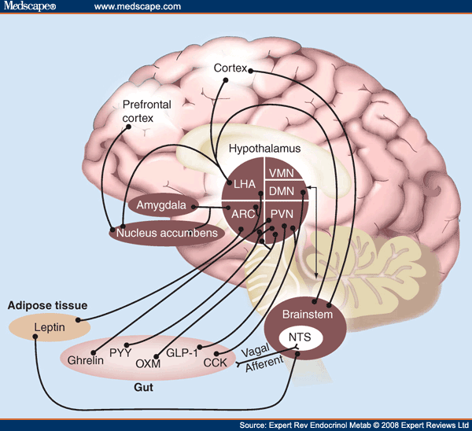
The Central Role of The Hypothalamus

Slide 13
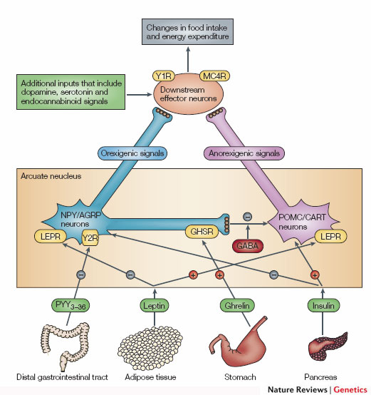
The POMC/AgRP Circuit
Promotes
Eating
Suppresses
Appetite
Notes:
Two populations of neurons in the arcuate nucleus.

Slide 14
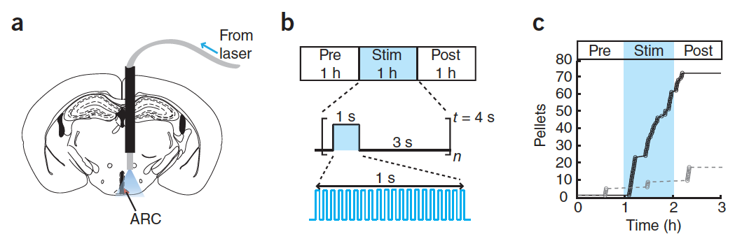
Regulation of AGRP Neurons is Sufficient to Control Hunger
Aponte Y, Atasoy D, Sternson SM. AGRP neurons are sufficient to orchestrate feeding behavior rapidly and without training. Nat Neurosci 2011; 14:351–5.

Slide 15
Demonstration of AGRP Suppression of Appetite
https://youtu.be/9VolVN3v-YQ
Notes:
AgRP neuron suppression

Slide 16
Neural Control of Appetite (Downstream of AGRP/POMC)
Syndromic obesity variants generally cause over-eating

Slide 17
Stress
Cortisol (a glucocorticoid stress hormone) activates AGRP Neurons
This drives feeding behavior
Adrenaline (a short term stress hormone) also drives appetite

Slide 18
Timed feeding cues
Cortisol awakening response
Sharp rise in cortisol shortly before waking up
May differ between chronotypes
48% genetic
How do you think this would affect feeding behaviors?
Kudielka BM, Federenko IS, Hellhammer DH, Wüst S. Morningness and eveningness: The free cortisol rise after awakening in “early birds” and “night owls.” Biol Psychol. 2006; 72: 141–6. doi: 10.1016/j.biopsycho.2005.08.003.

Slide 19
Why do we stop eating?
The role of our gastrointestinal system
Notes:
~20 minute lag between eating and feeling full

Slide 20
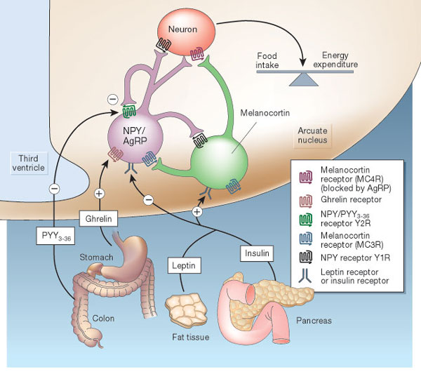
Hormonal Control of Appetite
Notes:
Think about it this way… AgRP neurons like to be on, and when they are on they increase appetite.

Slide 21
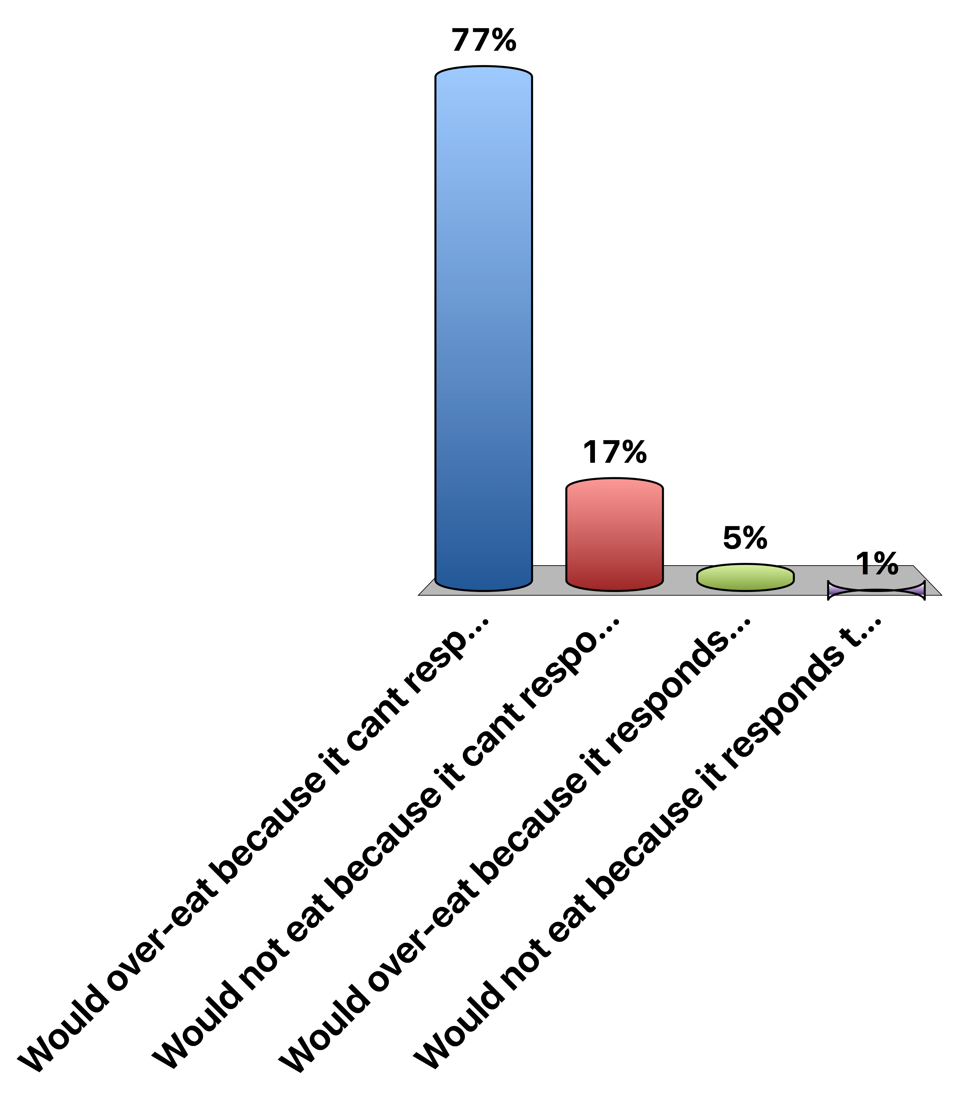
A person with no Leptin Receptor
Would over-eat because it cant respond to leptin
Would not eat because it cant respond to leptin
Would over-eat because it responds too strongly to leptin
Would not eat because it responds too strongly to leptin
0
Notes:
About 2.5% of early onset obese

Slide 22
Metabolic Signals
Glucose
Signals both at POMC/AgRP and other hindbrain regions to reduce appetitve drive
Insulin
Signals directly at POMC/AgRP circuit to reduce appetitive drive
Proteins and Fats
Potentially suppressive, mechanisms are unclear

Slide 23
Gastrointestinal Control of Appetite
Vagal Afferents
GLP-1
Notes:
Think about it this way… AgRP neurons like to be on, and when they are on they increase appetite.

Slide 24
Ghrelin, the Hunger Hormone

Slide 25
Ghrelin and Food Volumes
What foods are high volume, but low calories?
What foods are high calories but low volume?
How would ghrelin be affected by either

Slide 26
Vagal Nerve Signaling
Also activates the parasympathetic nervous system (rest and digest)
Notes:
Enteric nervous system
Second brain
500 million neurons

Slide 27
Peptide YY (PYY)
Senses lipids and proteins in our food
Secreted from the small intestine

Slide 28
GLP-1 (Glucagon-Like Peptide 1)
Senses carbohydrates in our food

Slide 29
GLP-1 Agonists as anti-Obesity Drugs
Liragutide is a GLP-1 analog
Wadden TA, Hollander P, Klein S, Niswender K, Woo V, Hale PM, Aronne L. Weight maintenance and additional weight loss with liraglutide after low-calorie-diet-induced weight loss: The SCALE Maintenance randomized study. Int J Obes. Nature Publishing Group; 2013; 37: 1443–51. doi: 10.1038/ijo.2013.120.

Slide 30
Summary of gut signals
Signal | Effect of food | Effect on Appetite
Vagal stimulation | Stimulation (various) | Inhibitory
GLP-1 | Secreted by small intestine (CHO) | Inhibitory
PYY (Peptide YY) | Secreted by small intestine (Protein/Lipid) | Inhibitory
Ghrelin | Stomach secretion stops with food | Activating

Slide 31
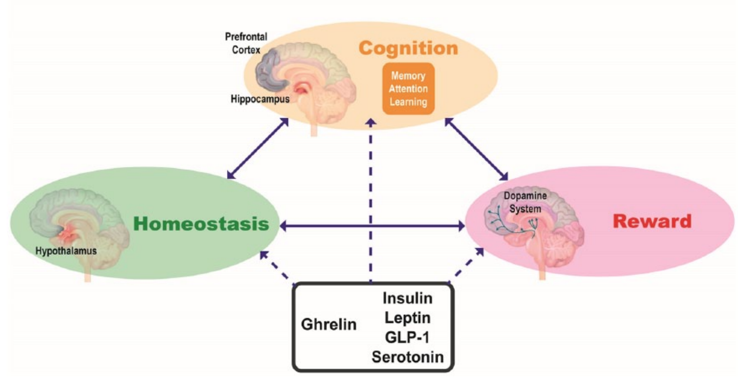
Reward Systems and Food Intake
What are some reward-related attributes that might relate to appetite
Higgs, S. et al. Interactions between metabolic, reward and cognitive processes in appetite control: Implications for novel weight management therapies. J. Psychopharmacol. 31, 1460–1474 (2017).

Slide 32
Mindful Eating Thought Experiment
Normal signals regulate drive to eat, and feelings of fullness
Dieting may change our normal responses
Mindful eating is proposed to restore normal sensing
Pretend you have an study of people who are or are not trained in mindful eating.
At your table, pick a physiological factor that you hypothesize would be different between these groups. How would it be different? How do you think intuitive eating might cause these effects?
Notes:
Be here at 1:45-1:55
One paper showed that higher resting vagal activity was associated with a lower willingness to eat desired foods (which would be associated with more diet restriction)

Slide 33
What is the relationship between intake and expenditure?

Slide 34
Relationship between activity and intake
Over a Day
Over the Week
Edholm OG. Energy balance in man studies carried out by the Division of Human Physiology, National Institute for Medical Research. J Hum Nutr. 1977; 31: 413–31.

Slide 35
Weight loss and appetite

Slide 36
How does weight loss affect appetite hormones
Why does ghrelin go down, but PYY go up with a meal?
Sumithran P, Prendergast LA, Delbridge E, Purcell K, Shulkes A, Kriketos A, Proietto J. Long-Term Persistence of Hormonal Adaptations to Weight Loss. N Engl J Med. 2011; 365: 1597–604. doi: 10.1056/NEJMoa1105816.

Slide 37
How does weight loss affect hunger?

Slide 38
Think-Pair-Share: Implications for Treatment
Imagine you are working in a weight management clinic.
A patient has lost weight, but reports feeling hungry. What advice could you give?
What are some potential consequences of ignoring their report of elevated hunger?
Notes:
Stereotyping– make attributions of lazy, undisciplined
Results - less utilization of care, emotional eating, elevated ambulatory blood pressure, lower physical activity, depression
Encouragement to try “harder”/again leading to chronic dieting and weight cycling--associated with much worse health: all-cause mortality, physiological/metabolic outcomes

Slide 39
Genetics Thought Experiment
What aspects of appetite do you think are
Non-familial
Familial, but non-genetic (V_{e})
Genetic (V_{g})
How much of total energy intake do you think is explained by genetics (V_{g})?
<20%
20-40%
40-60%
>60%
Notes:
21-45% of macronutrient intake is genetic

Slide 40
Learning Objectives
Discriminate between the different biological and psychological impulses to eat.
Explain the differences between energy intake, and energy ingestion and list some factors that may confound the relationship between intake and energy balance.
Describe the source and effects of gastrointestinal, hormonal and metabolic signals that affect appetite.
Consider how hormonal, metabolic and genetic factors may be predictive of feeding habits, and how this could inform individualized approaches.
Apply these biological mechanisms to predict how appetite suppressant drugs function.
Explain the relationships between energy expenditure and energy intake, including the timing of this relationship
Apply your knowledge of hunger hormones to explain the role of appetitive drive after a weight loss program, and how this affects sustained weight loss.

